Slide 1



SMART INDIA HACKATHON 2025
Problem Statement ID – 25117
Problem Statement Title- Student Innovation: Swadeshi for Atmanirbhar Bharat - Robotics and Drones
Theme- Robotics and Drones
PS Category- Hardware
Team ID-
Team Name - DroneAcharya

Slide 2
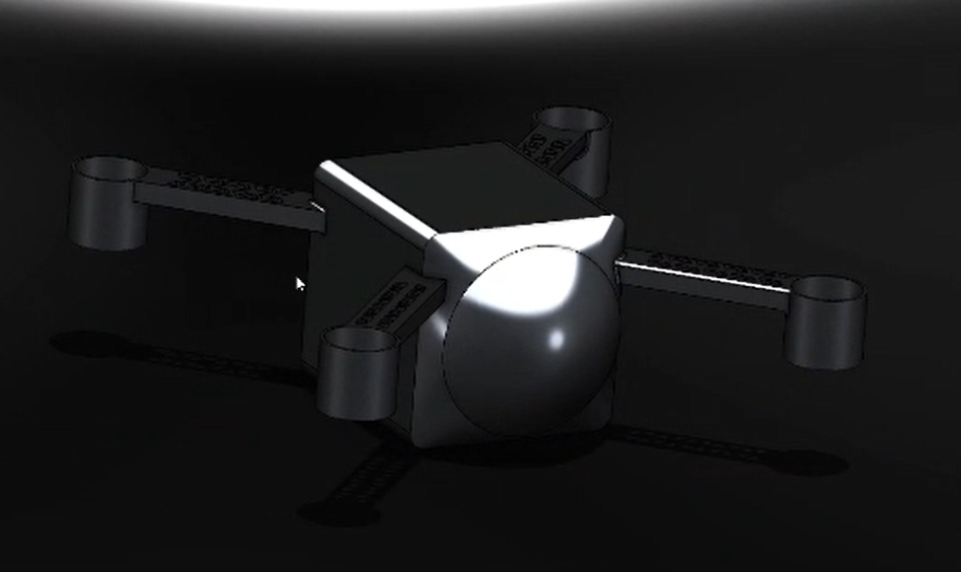
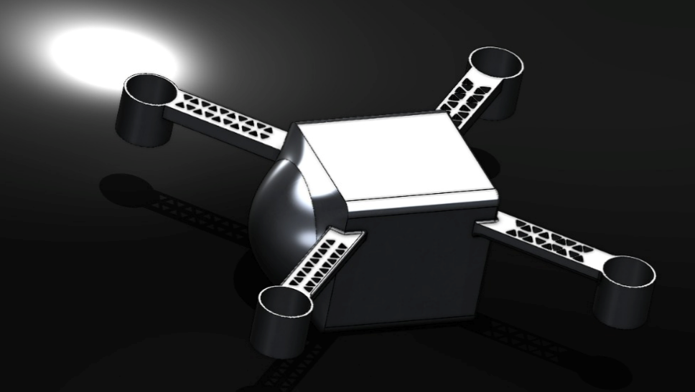
DroneAcharya
DRONES FOR RESCUE AND SURVEILLANCE
Proposed Solution
Our solution aims to significantly reduce the time required to locate disaster victims across large and difficult-to-access areas.
We propose a mothership drone system capable of deploying and individually controlling multiple smaller search drones. The mothership transports the drones into the disaster-affected zone, then releases them to conduct a coordinated search operation.
Each mini drone is equipped with thermal and optical cameras, enabling the detection of victims on rooftops, partially submerged structures, or stranded vehicles. The mothership acts as a central communication relay, collecting live data and transmitting the precise GPS coordinates of survivors directly to rescue authorities for rapid response.
To enhance targeting, a QFH antenna is integrated with the mothership, allowing access to satellite imagery that highlights the most severely affected areas. This ensures the drones are deployed exactly where they are needed most.
@SIH Idea submission- Template
2
Notes:
2

Slide 3
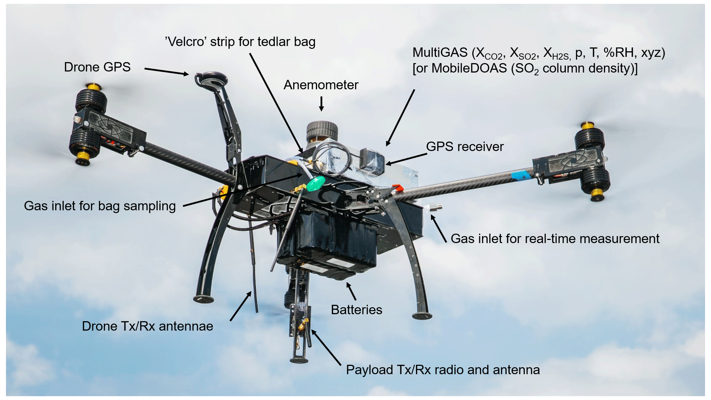
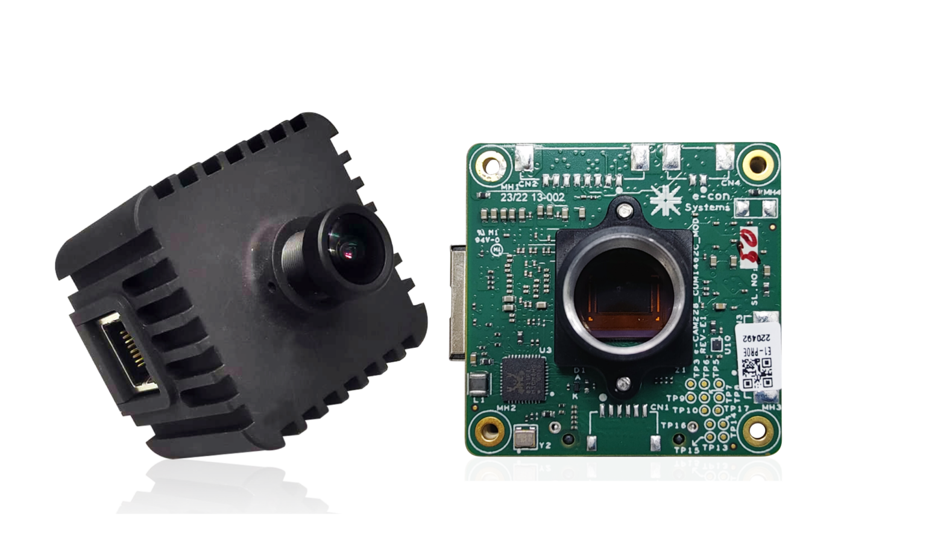
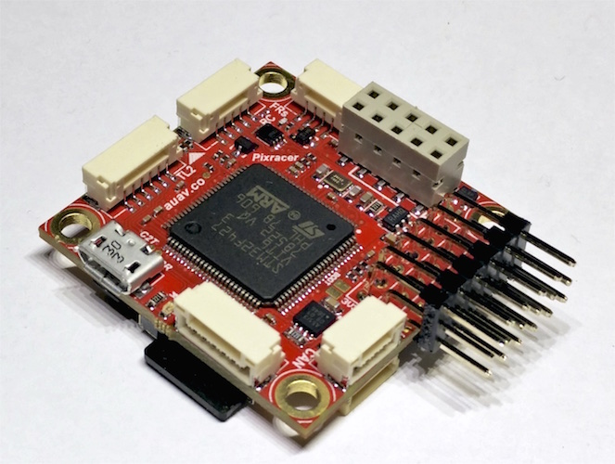

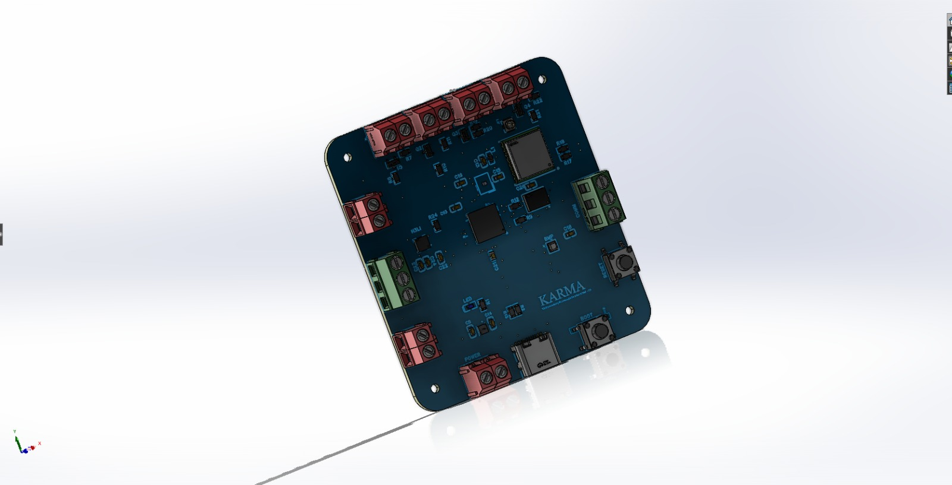
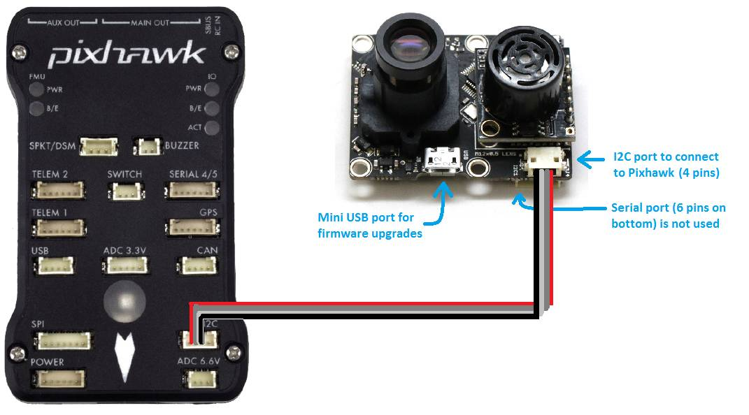
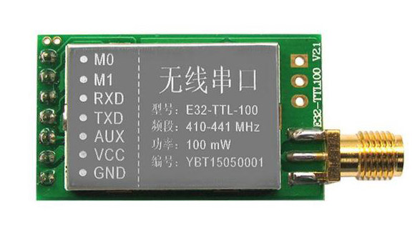
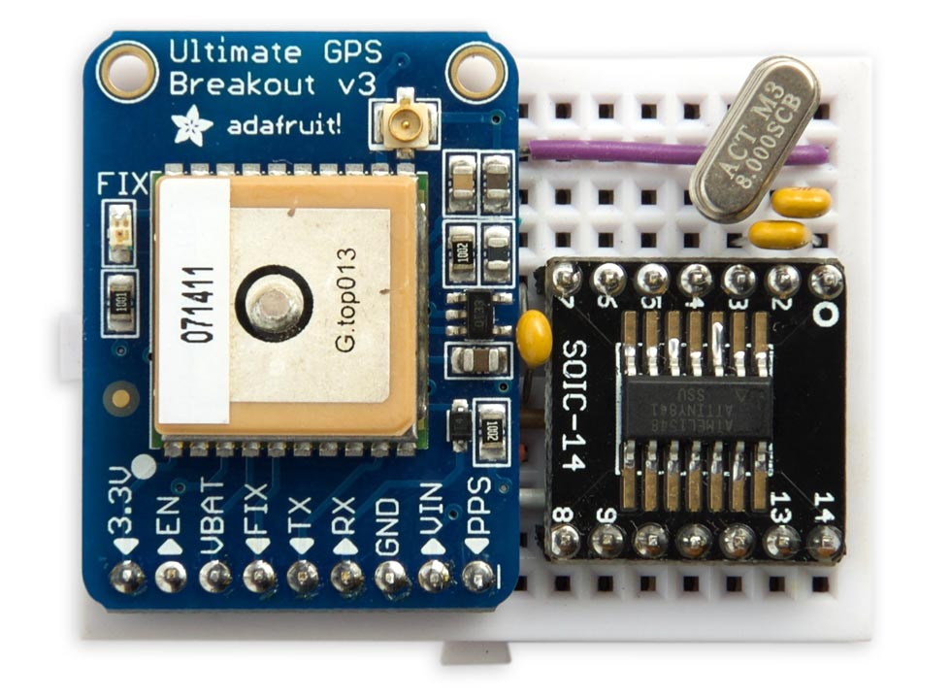
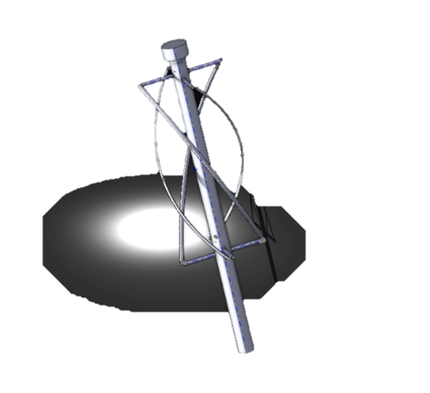
TECHNICAL APPROACH
DroneAcharya
Programming Languages
Python - Main control system & AI/ML algorithms
C++ - Low-level drone firmware
MATLAB - Signal processing for antenna
Hardware Components
Pixhawk 4 - Flight controller
Thermal camera module
Optical camera sensor
QFH Antenna - Satellite connectivity
GPS/GNSS Module - Positioning system
LoRa SX1276 - Long-range communication
4G/LTE Module - Cellular backup
SDR (Software Defined Radio)
MQTT Protocol - IoT messaging
Frameworks & Libraries
ROS (Robot Operating System) - Drone coordination
OpenCV - Image processing & victim detection
TensorFlow - Thermal image analysis
MAVLink - Communication protocol
Node.js & Socket.io - Real-time data streaming
@SIH Idea submission- Template
3
Notes:
3

Slide 4
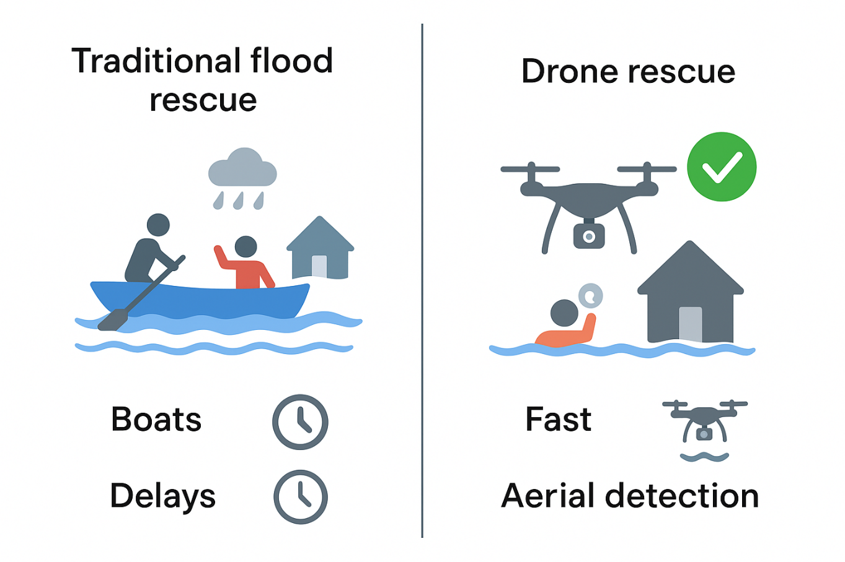
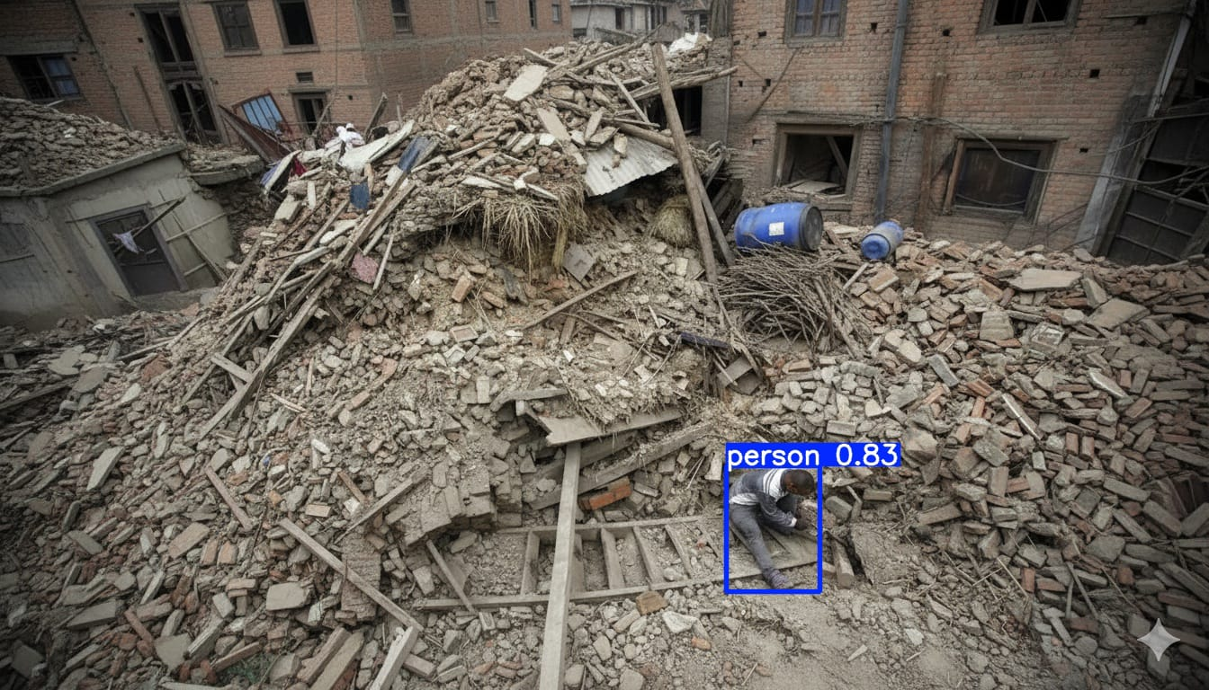
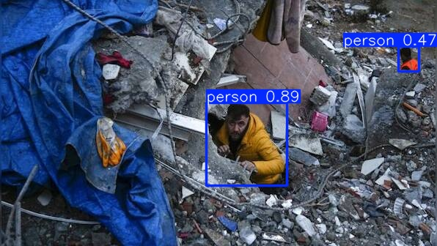
FEASIBILITY AND VIABILITY
DroneAcharya
Feasibility
The system is achievable with today’s technology — heavy-lift drones (mothership) exist
Pixhawk/STM32 flight controllers provide stable autopilot, and thermal/optical cameras are already proven in SAR (search and rescue).
Communication relays via mothership are supported by MAV Link and mesh networks.
Mini drones can cover areas faster than ground/boat teams.
Waterproofing and flight-time (20–30 mins per sortie) are realistic with current LiPo battery tech, though endurance is the main limiting factor.
Viability
Reduces victim discovery time, enabling quicker rescues
Mini drones can also deliver critical supplies (food, medicine, radios) until teams arrive.
Much cheaper than helicopters (crores per unit + high fuel costs).
This same system can be adapted for earthquakes (searching rubble), wildfires (thermal detection), landslides (victim locating), floods etc.
@SIH Idea submission- Template
4
Notes:
4

Slide 5
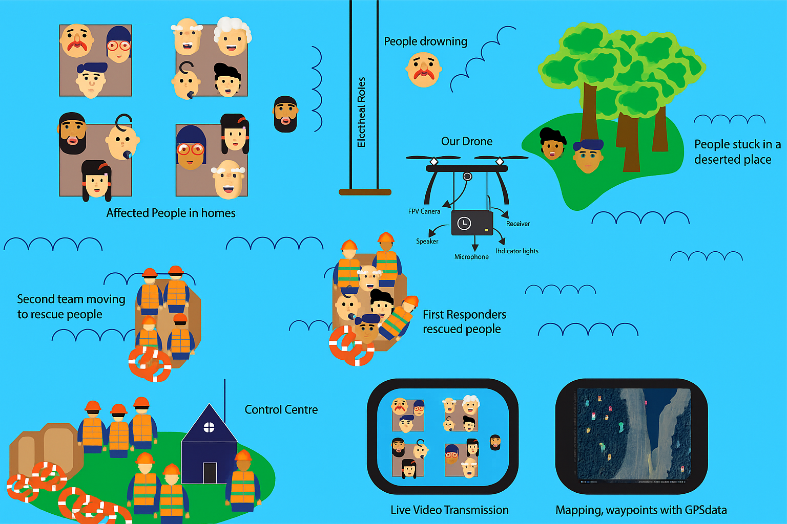
IMPACT AND BENEFITS
DroneAcharya
Impacts
Rapid victim detection and rescue
If one drone fails, others can continue operation.
Long-term cost savings through reusable systems.
Can integrate AI/ML for autonomous victim recognition.
Benefits
Social: More lives saved during time of calamity
Environmental: Drones are electric-powered
Economic: Lower operational and maintenance costs
5
@SIH Idea submission- Template
Notes:
5

Slide 6
RESEARCH AND REFERENCES
DroneAcharya
Paper: A multiple-drone arc routing and mothership coordination Authors: Lavinia Amorosi, Justo Puerto, Carlos Valverde Journal: Computers & Operations Research, 2023 Link: https://www.sciencedirect.com/science/article/pii/S0305054823001867
Paper: A LODBO algorithm for multi-UAV search and rescue path planning Authors: L. Yang Journal: Journal of Systems Engineering and Electronics, 2025 Link: https://www.sciencedirect.com/science/article/pii/S1000936124004540
Paper: Development of Drone for Search and Rescue Operation in Malaysia Flood Disaster Authors: Ahmad Sobri Hashim, Mohamad Syafiq Mohamad Tamizi Journal: International Journal of Engineering & Technology, 2018 Link : PDF Link
4. GitHub: https://github.com/Alv-dot/SIH_-MOTHERSHIP
@SIH Idea submission- Template
6
Notes:
6

